Slide 1
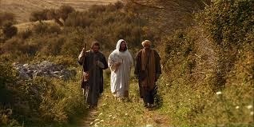
ON THE ROAD WITH JESUS
Come along with us!

Slide 2
LOOKING AT DANIEL . . . SEEING JESUS!

Slide 3
CONFUSING?

Slide 4
CONFUSING? Chapter 8 – 3rd year of Belshazzar

Slide 5
CONFUSING? Chapter 8 – 3rd year of Belshazzar Chapter 9 – 1st year of Darius

Slide 6
CONFUSING? Chapter 8 – 3rd year of Belshazzar Chapter 9 – 1st year of Darius Chapter 10 – 3rd year of Cyrus

Slide 7
CONFUSING? Chapter 8 – 3rd year of Belshazzar Chapter 9 – 1st year of Darius Chapter 10 – 3rd year of Cyrus Chapter 11 – 1st year of Darius again

Slide 8
Half of Daniel was written in Hebrew (chapters 1 and 8-12)

Slide 9
Half of Daniel was written in Hebrew (chapters 1 and 8-12) Half in Aramaic (chapters 2-7)

Slide 10
Aramaic—matters pertaining to all the citizenry of the Babylonian and Persian Empires.

Slide 11
Aramaic—matters pertaining to all the citizenry of the Babylonian and Persian Empires. Hebrew—relate to specifically Jewish concerns and God’s special plans for the future of His chosen covenant people.

Slide 12
Aramaic—many words from the Chaldean language, and there are three (3) words from the Greek language . . .

Slide 13
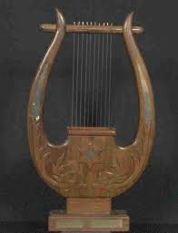
the lyre . . .

Slide 14
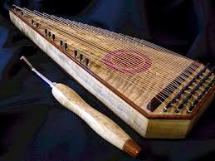
the psaltery . . .

Slide 15
and the bag pipe.

Slide 16
King says, “son of the gods” [Daniel 3:25] . . .

Slide 17
King says, “son of the gods” [Daniel 3:25] . . . Daniel uses the Chaldean word for god [el-aw’—idol, little god, important god, etc.] . . .

Slide 18
King says, “son of the gods” [Daniel 3:25] . . . Daniel uses the Chaldean word for god [el-aw’—idol, little god, important god, etc.] . . . not the Hebrew word we translate as LORD, YHWH, or Jehovah.

Slide 19
I. NEBUCHADNEZZARS’ FORGOTTEN DREAM— DANIEL 2

Slide 20
I. NEBUCHADNEZZARS’ FORGOTTEN DREAM

Slide 21
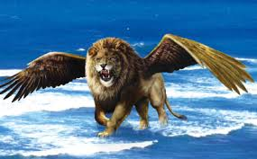
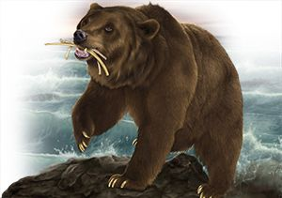
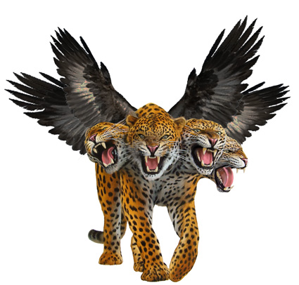
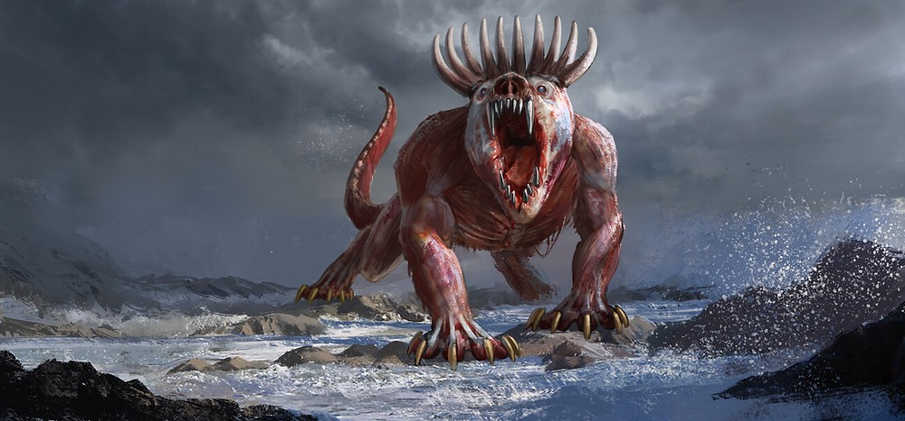
II. DANIEL’S DREAM OR VISION OF THE FOUR BEASTS—DANIEL 7

Slide 22
III. THE COMPARISON OF THE TWO DREAMS

Slide 23
III. THE COMPARISON OF THE TWO DREAMS Head of Gold – First Beast the Lion

Slide 24
Daniel 2:47 “Surely your God [el-aw’] is a God [el-aw’] of gods [el-aw’] and a Lord of kings and a revealer of mysteries, since you have been able to reveal this mystery.”

Slide 25
Jeremiah 4:6-7 “Lift up a standard toward Zion! Seek refuge, do not stand still, for I am bringing evil from the north [emphasis mine], and great destruction. . . .

Slide 26
[7] A lion has gone up from his thicket, and a destroyer of nations has set out; he has gone out from his place to make your land waste. Your cities will be ruins without inhabitant.”

Slide 27
Ezekiel 17:3, 11-12 Thus says the Lord God, “A great eagle with great wings, long pinions and a full plumage of many colors came to Lebanon and took away the top of the cedar.” . . .

Slide 28
[11] Moreover, the word of the Lord came to me, saying, [12] “Say now to the rebellious house, ‘Do you know what these things mean?” . . .

Slide 29
Say, ‘Behold, the king of Babylon came to Jerusalem, took its king and princes and brought them to him in Babylon.’”

Slide 30
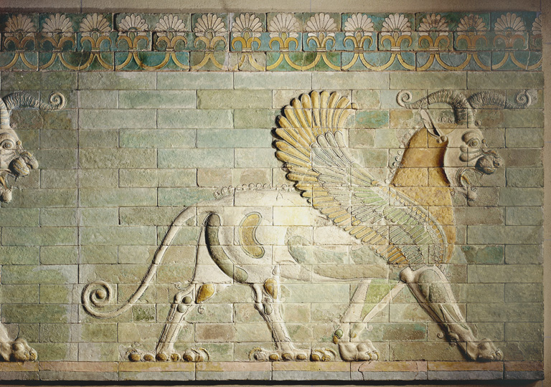

Slide 31
III. THE COMPARISON OF THE TWO DREAMS Head of Gold – First Beast the Lion Chest of Silver—Second Beast the Bear

Slide 32
III. THE COMPARISON OF THE TWO DREAMS. Head of Gold – First Beast the Lion Chest of Silver—Second Beast the Bear Belly and Thighs of Bronze—Third Beast Leopard with Four Heads

Slide 33
III. THE COMPARISON OF THE TWO DREAMS. Head of Gold – 1st Beast the Lion Chest of Silver—2nd Beast the Bear Belly/Thighs Bronze—3rd Beast Leopard Legs of Iron and Feet of Iron and Clay—the Terrifying Fourth Beast

Slide 34
Daniel 2:43 “And in that you saw the iron mixed with common clay, they will combine with one another in the seed of men; . . .

Slide 35
but they will not adhere to one another, even as iron does not combine with pottery.”

Slide 36
III. THE COMPARISON OF THE TWO DREAMS. Head of Gold – 1st Beast the Lion Chest of Silver—2nd Beast the Bear Belly/Thighs Bronze—3rd Beast Leopard Legs of Iron/Feet of Iron/Clay—4th Beast Stone Cut Not Cut by Human Hands—Everlasting Kingdom

Slide 37
Daniel 2:44-45 In those days of those kings the God [el-aw’] of heaven will set up a kingdom which will never be destroyed, and that kingdom will not be left for another people; ...

Slide 38
It will crush and put an end to all these kingdoms, but it will itself endure forever. [45] Inasmuch as you saw that a stone was cut out of the mountain without hands and it crushed the iron, the bronze, the clay, the silver, . . .

Slide 39
and the gold, the great God [el-aw’] has made known to the king what will take place in the future; so the dream is true and its interpretation is trustworthy.

Slide 40
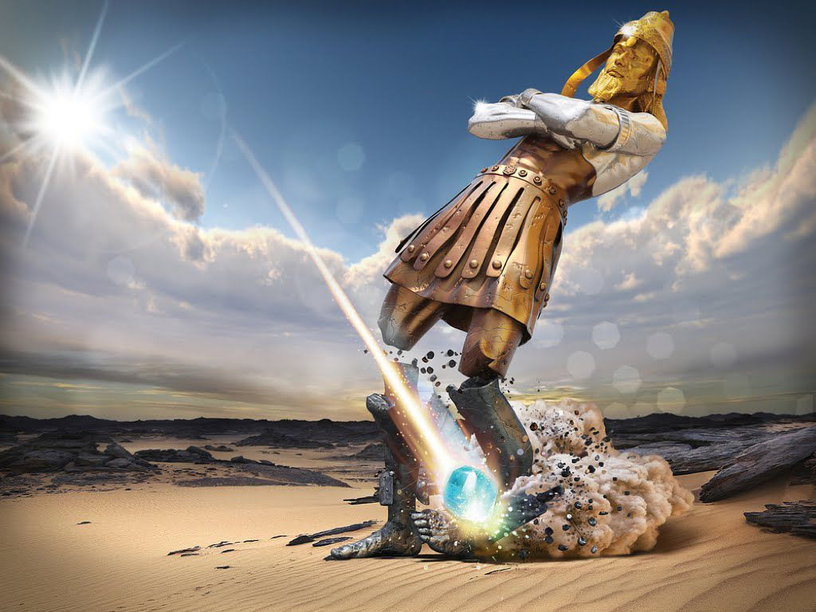

Slide 41
. . . Coming in the clouds One like a Son of Man [Jesus] who approaches the Ancient of Days [God the Father]. Daniel 7:13.

Slide 42
Daniel 7:14 And to Him was given dominion, glory and a kingdom, that all peoples, nations and men of every language might serve Him. . . .

Slide 43
His dominion is an ever-lasting dominion which will not pass away; and His kingdom is one which will not be destroyed.

Slide 44
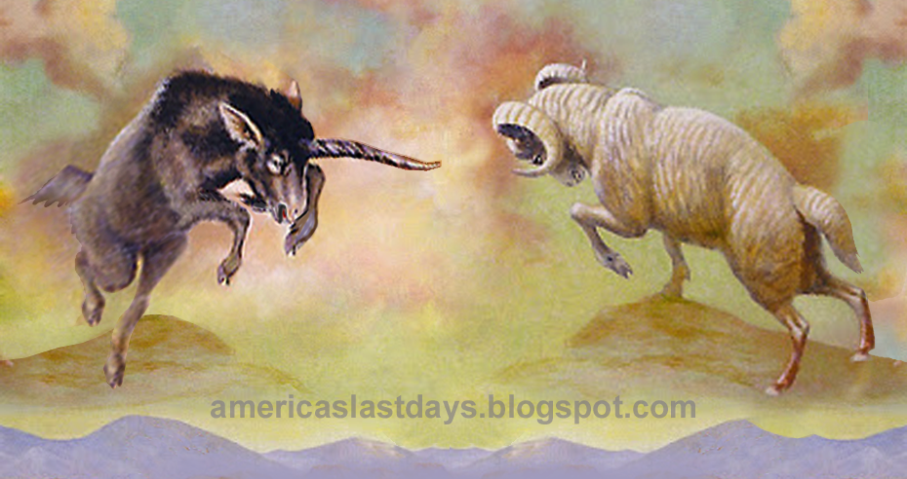
IV. DANIEL’S VISION OF THE RAM AND THE GOAT— DANIEL 8

Slide 45
175-164 B.C. Antiochus IV Epiphanes—tried to force the Jews to abandon their law and adopt Greek culture [Hellenism].

Slide 46
167 B.C. he banned all Jewish sacrifices, he massacred faithful Jews . . . and he desecrated the Jewish temple by sacrificing a PIG on the altar of the temple.

Slide 47
Jewish priest named Judas Maccabeus lead a revolt in the 164 B.C. the temple was cleansed and rededicated. This rededication is celebrated every year in Jewish society as . . .

Slide 48
Hanukkah.

Slide 49
V. DANIEL’S PRAYER FOR HIS PEOPLE—DANIEL 9

Slide 50
LORD and Lord 18 times . . .

Slide 51
LORD and Lord 18 times . . . 8 times LORD YHWH . . .

Slide 52
LORD and Lord 18 times . . . 8 times LORD YHWH . . . 10 times Lord Adonoy . . .

Slide 53
LORD and Lord 18 times . . . 8 times LORD YHWH . . . 10 times Lord Adonoy . . . “God” [Elohim] 8 times—5 times with LORD and 3 times with Lord.

Slide 54
SO WHAT?

Slide 55
Both Daniel and Jesus lived an exemplary life.

Slide 56
Both are brought before a ruler, facing trumped up charges, and the ruler’s hand is forced in bringing judgement on them.

Slide 57
Both are put in some kind of cave or pit which is closed with a stone and sealed with a seal.

Slide 58
Both come out alive and angels are involved.

Slide 59
Both are vindicated and exalted.

Slide 60
Jesus died and was then raised.

Slide 61
Daniel faced death because of human sinfulness and pride; . . .

Slide 62
Daniel faced death because of human sinfulness and pride; . . . Jesus experienced death for human sinfulness and pride.

Slide 63
These enemies of God were themselves “thrown into the lion’s den” [verse 24].

Slide 64
The wonder of the cross is that Jesus went there to be punished by God so that His enemies would never need to be.

Slide 65
Daniel 12:2-3 “Many of those who sleep in the dust of the ground will awake, these to everlasting life, but the others to disgrace and everlasting contempt. . . .

Slide 66
[3] Those who have insight will shine brightly like the brightness of the expanse of heaven, and those who lead many to righteousness, like the stars forever and ever.”

Slide 67
God doesn’t give us knowledge about the future so we can stand around craning our necks toward heaven, speculating on the time of His arrival.

Slide 68
He gives us prophecy to drive us forward.

Slide 69
He gives us prophecy to drive us forward. To encourage us.

Slide 70
He gives us prophecy to drive us forward. To encourage us. To change us.

Slide 71
Are we ready for change?

Slide 72
ON THE ROAD WITH JESUS
Come along with us!

